Slide 1
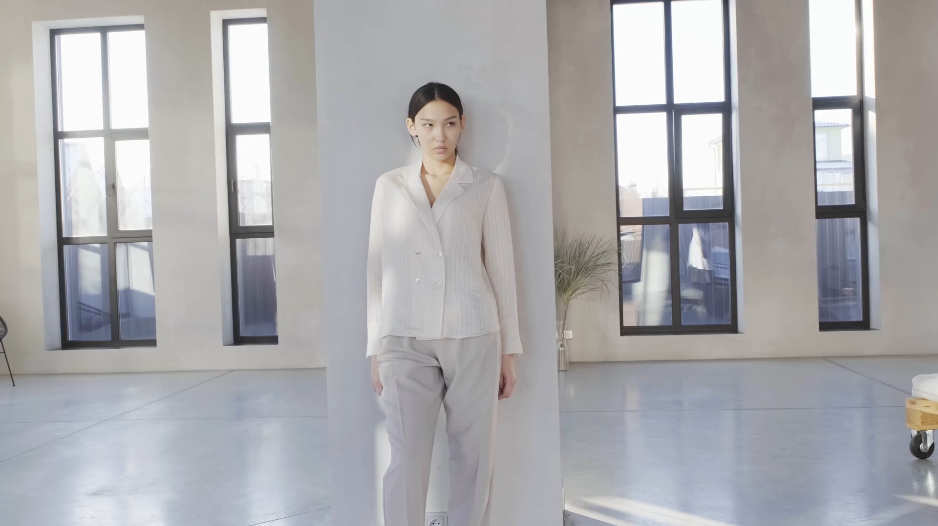
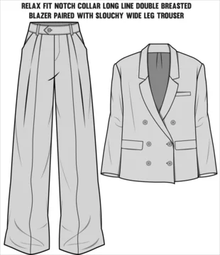
A sleek elegant Jacket that gives you comfort in every way u can wear . Comes with simple and specially vintage design to suit your particular fashion.
A sample to see through and get your design ready to go. 🎶
JACKET
Bright

